Slide 1
Rectangular coordinate systems, Planes and Lines

Slide 2
(I)
Rectangular
Coordinate System

Slide 3
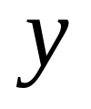
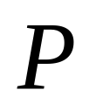
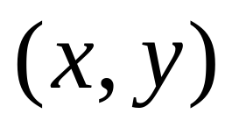


平面直角坐标系
1-1对应

Slide 4

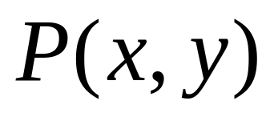
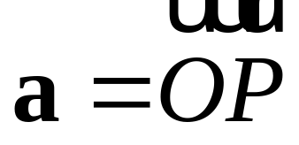
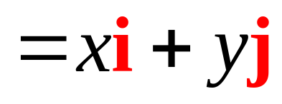
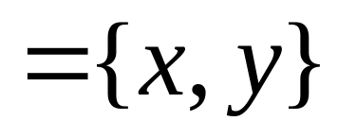
矢量的坐标

Slide 5
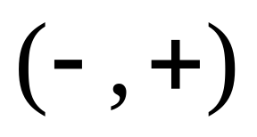
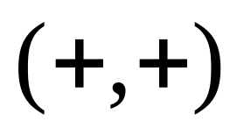
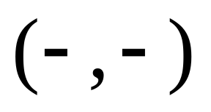
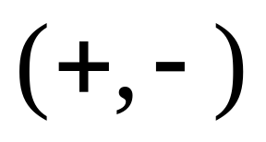
II 象限
I 象限
III 象限
IV 象限

Slide 6

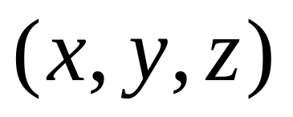

空间直角坐标系
1-1对应

Slide 7

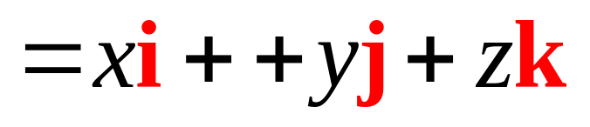
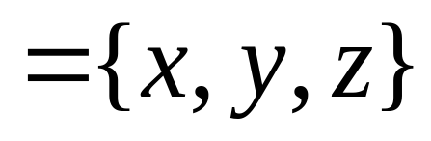
空间直角坐标系

Slide 8

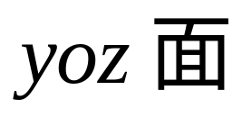
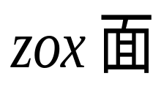

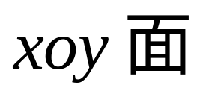


三个坐标轴
三个坐标面

Slide 9
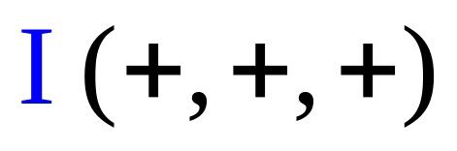
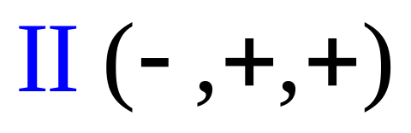
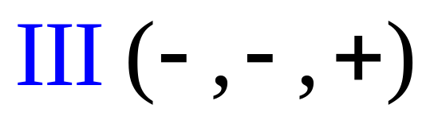
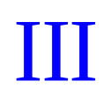
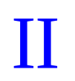
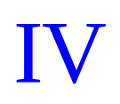
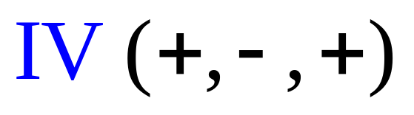

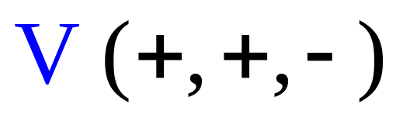
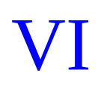
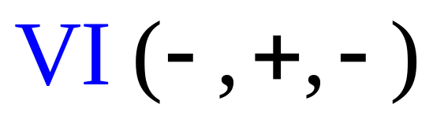
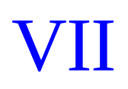

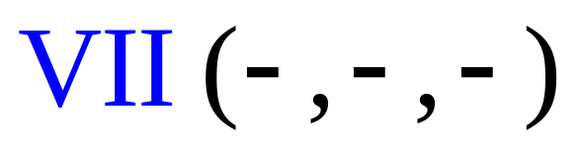
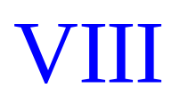
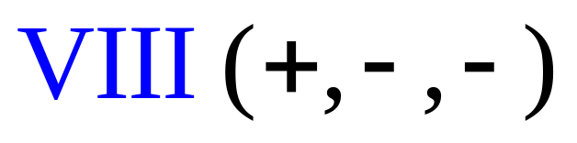
八个卦限

Slide 10
III卦限
z
II卦限
yOz面
IV卦限
zOx面
I卦限
O
y
xOy面
VI卦限
VII卦限
x
V卦限
空间直角坐标系
VIII卦限

Slide 11

z
III
II
IV
I
O
y
VII
VI
VIII
V
x
八卦限

Slide 12
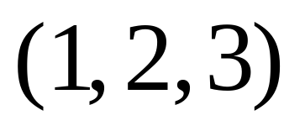
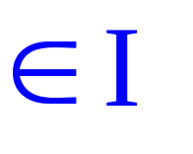
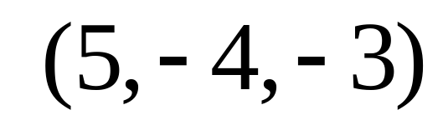
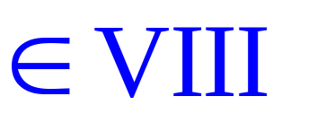
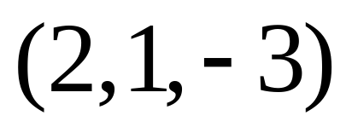
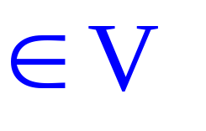
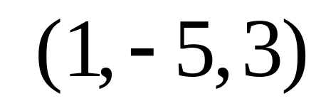
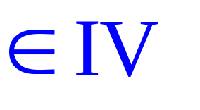

Slide 13



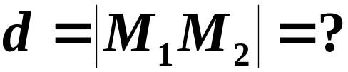


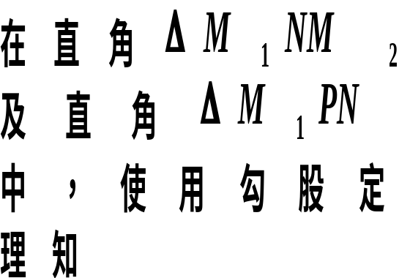




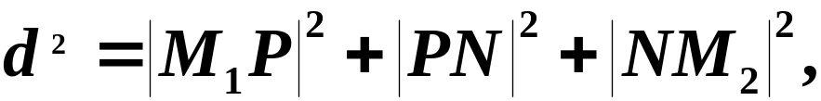

Slide 14



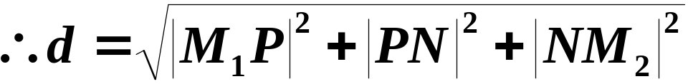


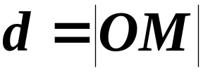
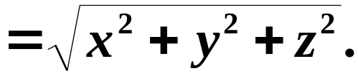
空间两点间距离公式
特殊地：若两点分别为

Slide 15
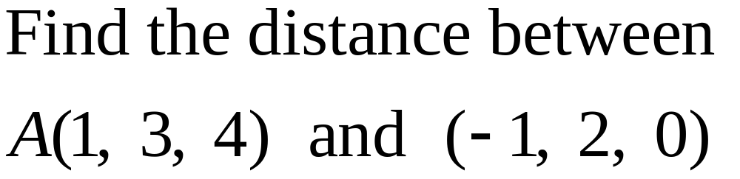
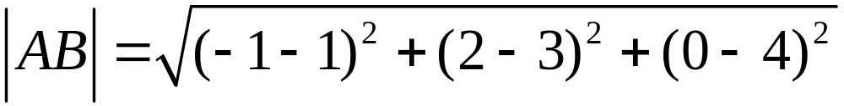
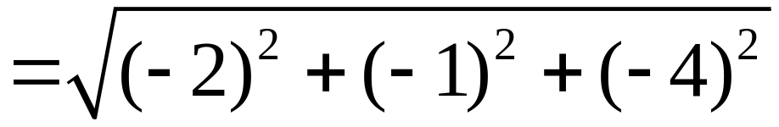
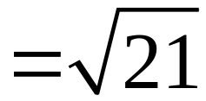
Example
Solution

Slide 16







在坐标系中画出点的位置

Slide 17

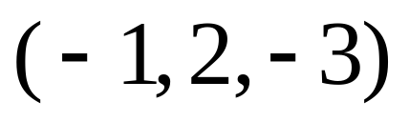


Slide 18




Slide 19







具有特殊位置的点的坐标
yz面：x=0
zx 面：y=0
xy面：z=0

Slide 20














矢量的模的计算公式

Slide 21









方向余弦

Slide 22



方向余弦的性质direction cosine

Slide 23
（II）Planes

Slide 24




Find an equation for the plane passing through the point M₀(x₀, y₀, z₀) with a normal vector n＝{A, B, C}

Slide 25









Slide 26



Point-normal equation for a plane
n＝{A, B, C}
normal vector

Slide 27


Linear equation
Conversely any graph with equation of the form
is a plane with normal vector n＝{A, B, C}

Slide 28

Example
Find an equation of the plane passing through the point (2, 5, -3) and is perpendicular to the vector n＝{1, 2, 5}
Solution
By the point-normal equation
We have
That is

Slide 29





Slide 30





Example
Find an equation for the plane passing through the three point A (2, -1, 4) , B(-1, 3, -2), C(0, 2, 3) which are not collinear
Solution
The key is to find a normal vector n

Slide 31



Find an equation for the plane passing through the three point A (2, -1, 4) , B(-1, 3, -2), C(0, 2, 3) which are not collinear
And so

Slide 32


Slide 33






In general, we will see
Coplanar, mixed product is 0

Slide 34



Slide 35



Determinant form of an equation of the plane determined by 3 points
Find a equation for the plane passing the three points

Slide 36



Some special planes
Passes through the origin

Slide 37


Parallel to the x-axis
Since a normal vector is n＝{0, B, C} which is perpendicular to x
parallel to x-axis : x missing
parallel to y axis : y missing
parallel to z axis : z missing

Slide 38


Contains the x-axis (the x axis lies in the plane)

Slide 39





parallel to the xy-plane

Slide 40





xy plane

Slide 41






Intercept form
are all in the plane

Slide 42






Example
Find the intercepts-form equation for the plane
Solution
Find a point-normal form equation for the plane ?

Slide 43





Example
Find an equation for the plane passing the point (2, -1, 3) and containing the y axis
Solution
Suppose an equation is
Plug in : x = 2, y= -1 z = 3 ?
Since the plane contaisns the y axis, B=0 and D=0.
Plug in : x = 2, y= -1 z = 3 .
Answers:

Slide 44






Example
Identify these planes
Solution
parallel to the z axis
y axis lies in the plane
Parallel to the yz plane
x axis lies in the plane

Slide 45
（III）Lines

Slide 46


Find an equation for the line passing through a fixed point M₀(x₀, y₀, z₀) and parallel to the vector l＝{m, n, p}

Slide 47








vector equation

Slide 48






parametric equations

Slide 49


symmetric equations
m, n, p
direction numbers

Slide 50





An equation for the line passing through two points
M₁(x₁, y₁, z₁) , M₂(x₂, y₂, z₂ )
Direction vector
The symmetric equations are
Two Points-form

Slide 51






A line can be considered as the line of intersection of two planes.
General equations

Slide 52



L direction vector

Slide 53



Example
Find equations for the line passing through the point (5, -1, 2) and is parallel to the vector l = {3, 4, 7} （symmetric, parametric, general forms）
Solution
symmetric
Parametric,
General ：

Slide 54

General equations
Answer is not unique.

Slide 55




Example Find symmetric equations for the line
Solution Direction vector
So,

Slide 56




To find a point on the line,
let z = 0 (or x = 0 or y=0)
（一条直线至少会通过 xy平面, yz 平面或 zx平面）
So we get a point
It is in the xy plane

Slide 57


So the symmetric equations
If let x = 0，then we could have had another point (0, -1, 1) on L
So another symmetric equations are

Slide 58



Find the point of intersection of the line and the plane：
Method 1
Solving the system of linear equations
So the point is
Cramer Rule

Slide 59



Method 2
Symmetric equations of the line
substitution：
The point is

Slide 60
（IV）
Distance from a point to a plane or a line

Slide 61





1 Distance from a point to a plane
Find the distance d from the point M₀(x₀, y₀, z₀) to the plane Ax+By+Cz+D=0
Normal vector：n={A, B, C}
M₁(x₁, y₁, z₁) is any point in the plane
θ
Then

Slide 62





θ

Slide 63




Ax+By+Cz+D=0

Slide 64



M₀(x₀, y₀, z₀)
Ax+By+Cz+D=0

Slide 65




Example Find the shortest distance from the point (2, 1, 1) to the plane x + y – z+1=0
Solution

